Slide 1
Computer Vision: Image Rectificatio & Stereo
Umberto Castellani

Slide 2
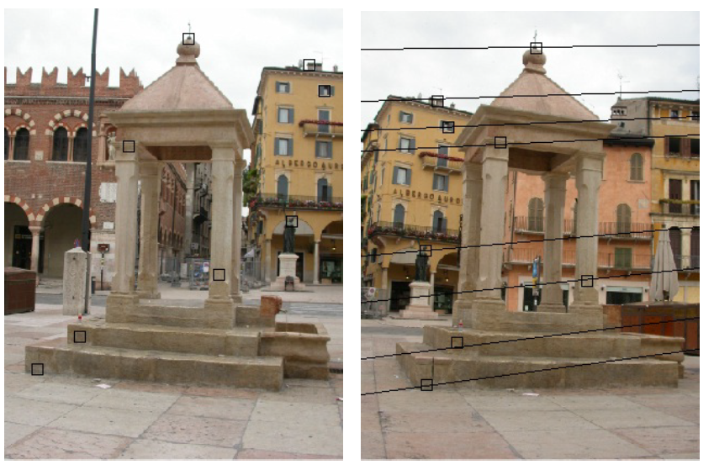
Epipolar Geometry

Slide 3
Stereo correspondence
Pairs of points that correspond to same scene point
epipolar line
epipolar line
epipolar plane
Epipolar Constraint
Reduces correspondence problem to 1D search along conjugate epipolar lines

Slide 4
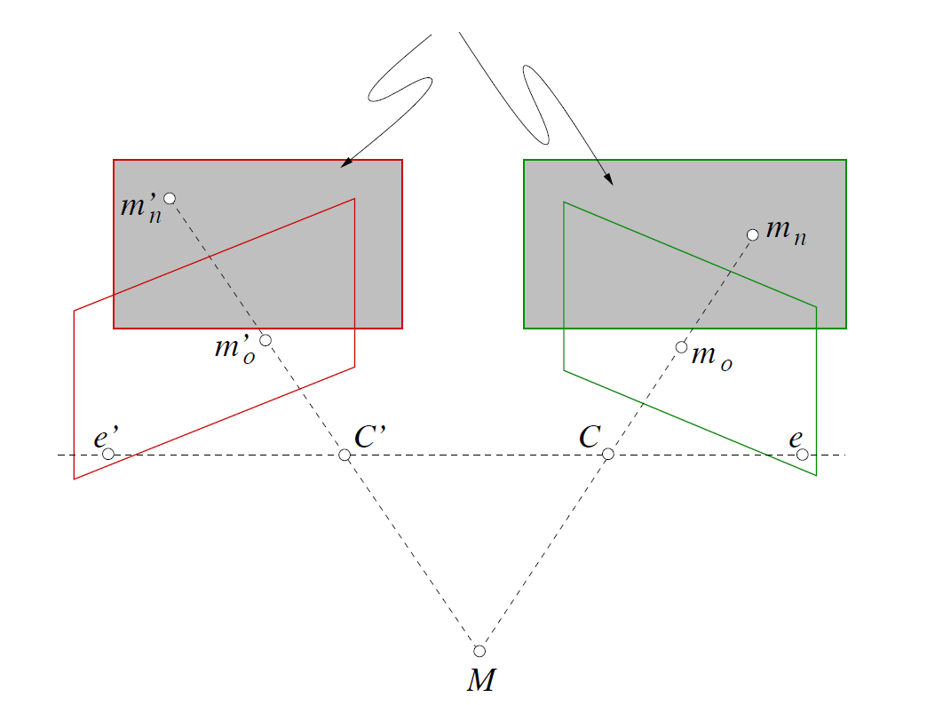
Image rectification

Slide 5
Image rectification
Image Reprojection
reproject image planes onto common plane parallel to line between optical centers
a homography (3x3 transform) applied to both input images
pixel motion is horizontal after this transformation
C. Loop and Z. Zhang. Computing Rectifying Homographies for Stereo Vision. IEEE Conf. Computer Vision and Pattern Recognition, 1999.

Slide 6
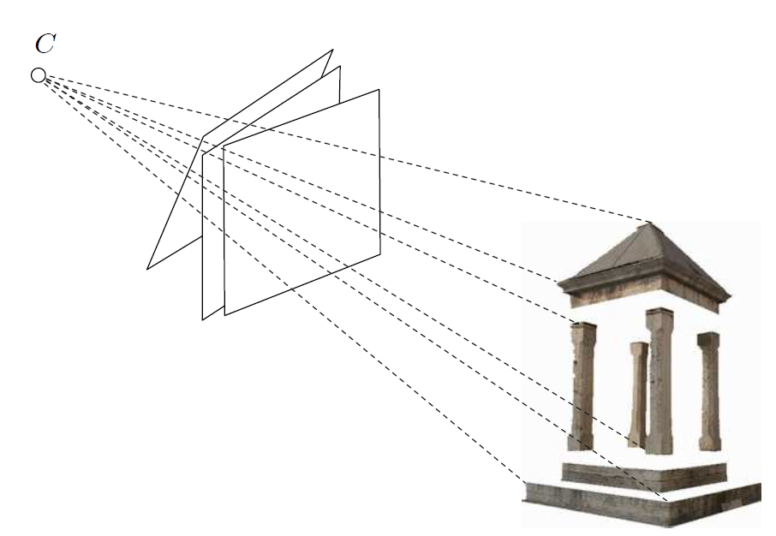
Image Rectification

Slide 7
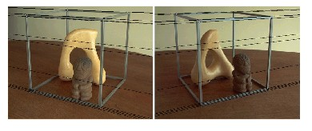
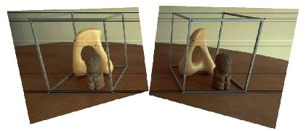
Image rectification

Slide 8
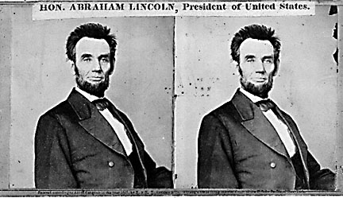
Your basic stereo algorithm
Matching cost
disparity
For each epipolar line
For each pixel in the left image
compare with every pixel on same epipolar line in right image
pick pixel with minimum match cost
Improvement: match windows

Slide 9
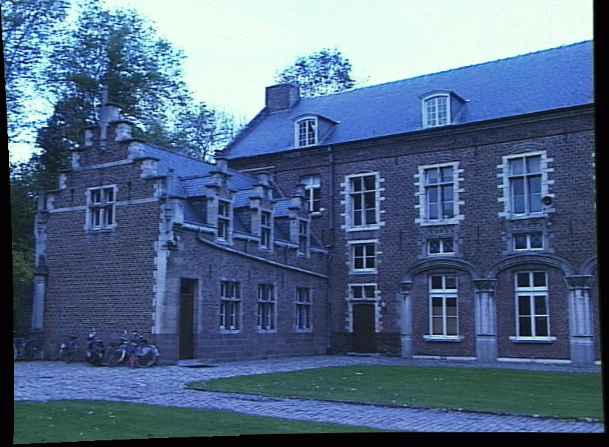
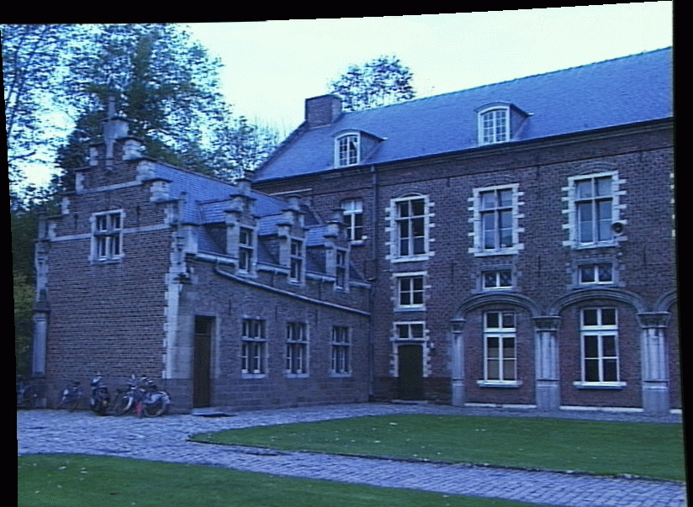
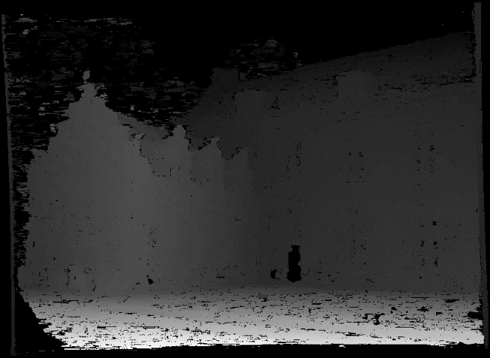
Passive stereo
image 1
image 2
Dense disparity map

Slide 10
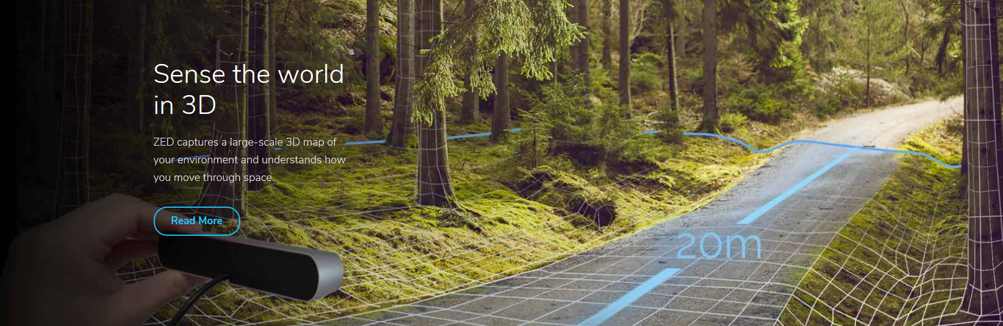
Stereo camera
https://www.stereolabs.com/

Slide 11
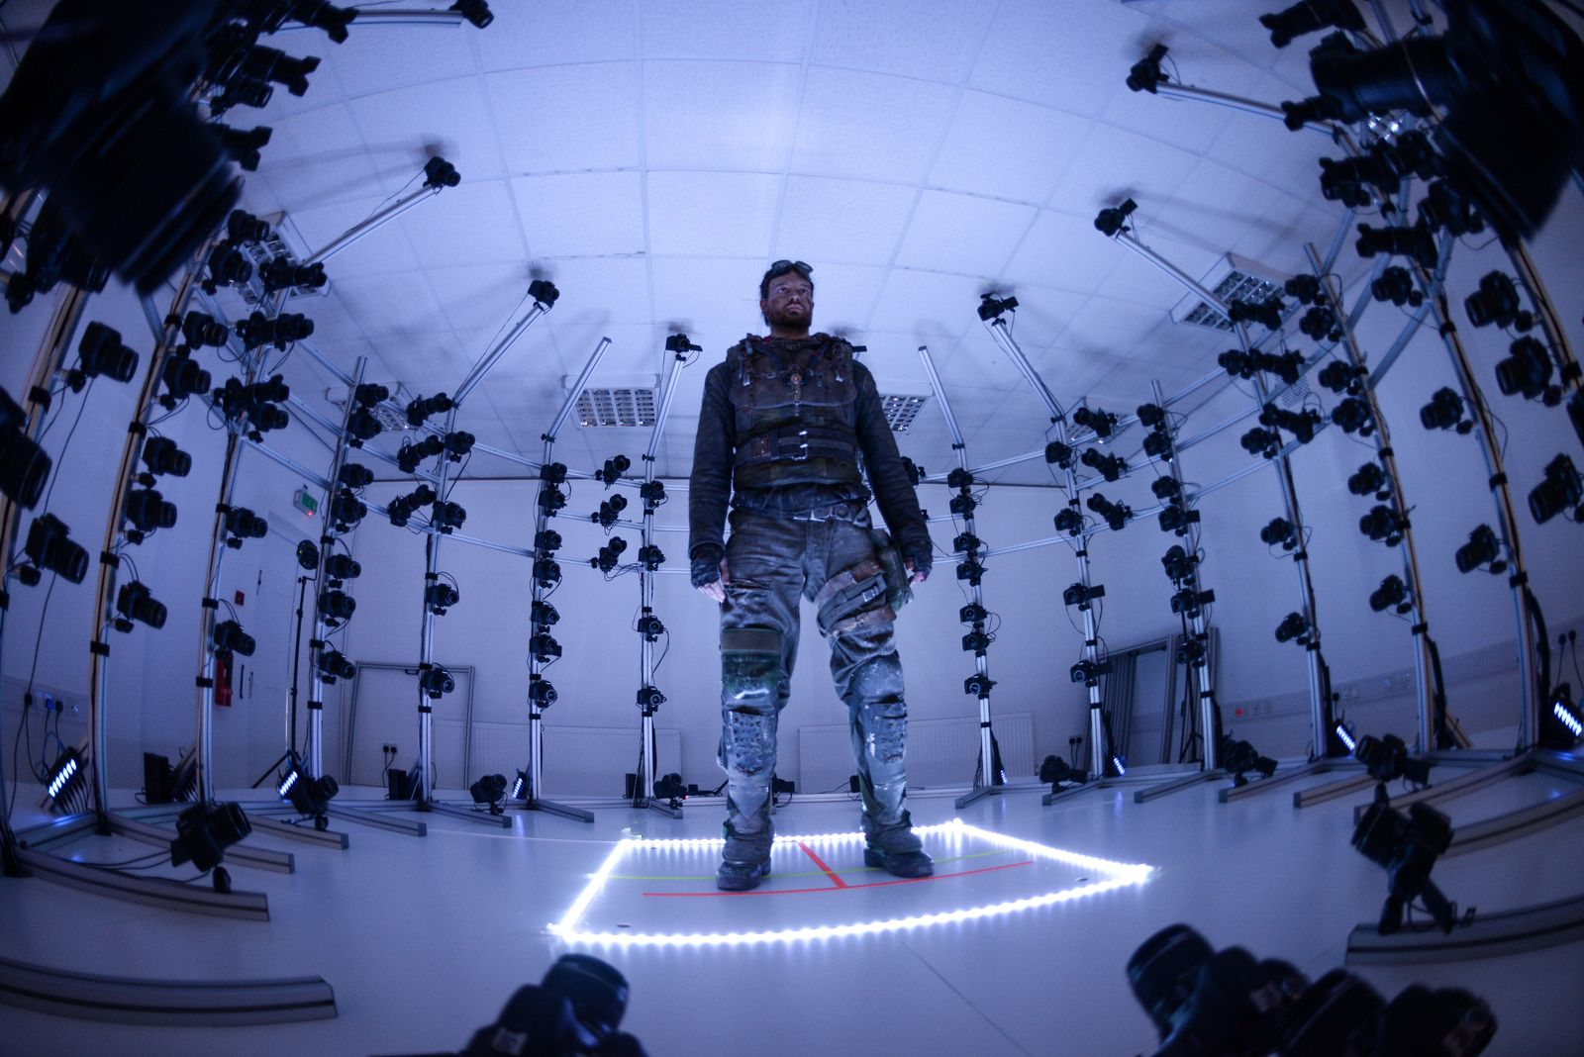
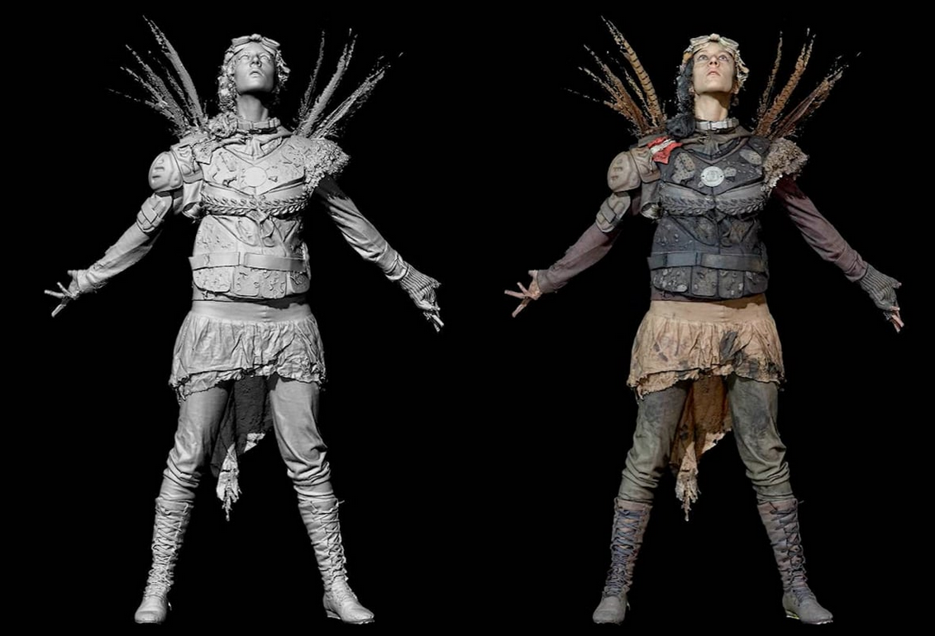
Multiview passive stereo
Larger baseline (i.e., distance between cameras)

Slide 12
The role of the baseline
Small Baseline
Large Baseline
Small baseline: large depth error
Large baseline: difficult search problem
Source: S. Seitz

Slide 13
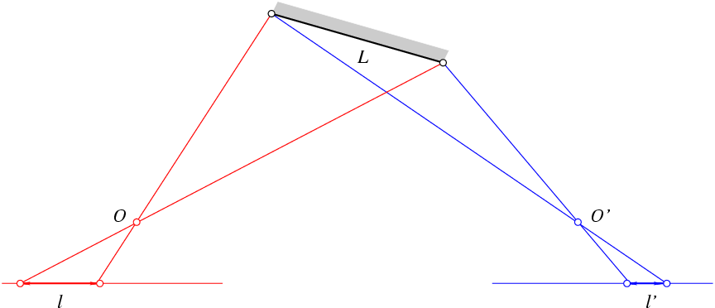
Problem for wide baselines: Foreshortening
Matching with fixed-size windows will fail!
Possible solution: adaptively vary window size

